Slide 1
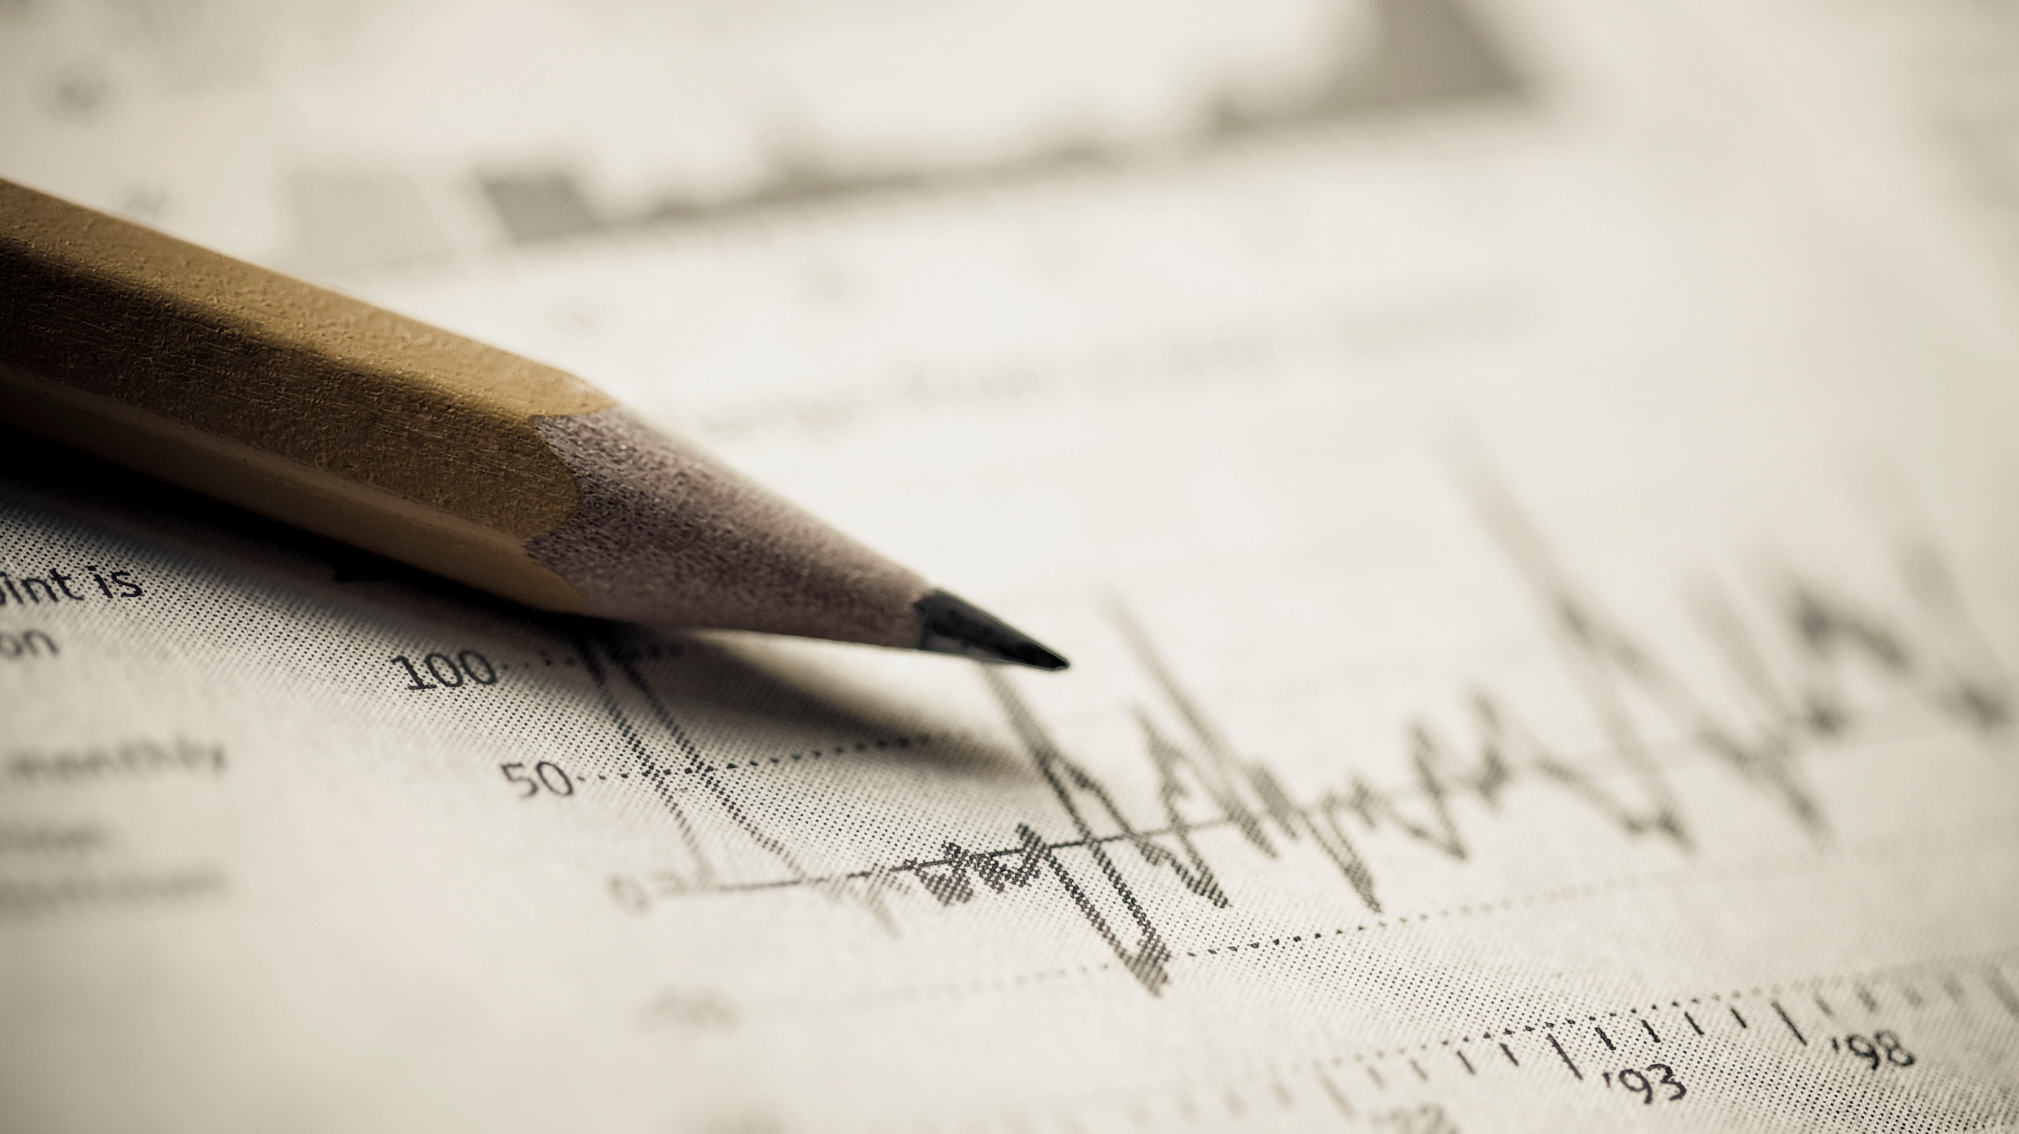
Big data in housing development
Armin Sanson Rakhshandeh

Slide 2
Agenda
Using big data in power management
Submeters role in producing big data
Big data analytics
Predict future consumption

Slide 3
Background
A large regional residential developer is designing a large 'Smart Home' apartment housing development and is looking for evidence or positive reasons for adopting the use of electrical sub-metering devices used for power management in Smart Homes.
Installing these sub-meters could be a big step towards the developer's goal of offering highly efficient Smart Homes that provide owners with power usage analytics - a large piece of their planned marketing efforts.

Slide 4
Objectives
To find enough evidence to help support the developer's marketing claims of sub-meters providing owners with 'useful' power usage analytics.
To demonstrate that we can predict future energy consumption from the same data; this would help further support their adoption of sub-meters from the viewpoint of possible energy consumption reduction and a monetary savings as a result

Slide 5
Data management
We will be performing an 'analytical deep dive' of sub-metering generated data and producing high quality visualizations that support a positive narrative or story around your findings.
The data sets are located on an online database; We accessed the data through a secure SQL connection provided by client.
We be using R studio Data frame to perform 'analytical deep dive

Slide 6
Data Description
47 months of energy usage (From 2006 to 2010)
10 variables: Id,Date,Time,Global_active_power,Global_reactive_power, Global_intensity, Voltage, Sub_metering_1, Sub_metering_2, Sub_metering_3
Total of 2049280 of records across the 47 months

Slide 7
Issues
Formatting of date and time: the formatting of the date and time are not friendly with our analytics tool. They need to be converted to fit the models.
Missing Data: 2006 and 2010 annual years are missing data , so we are going to remove them form analysis

Slide 8
Descriptive Statistics
Total number of observation with complete data(2007,2008,2009): 1,569,894
Max usage: Sub meter 3 with average of 6.2 watt per hour
Min usage: Sub meter 1 with average of 1.1 watt per hour
Capacity: Sub meters 1 and 2 shows that they can go up to over 70 watt per hour in certain time and days while submeter 3 kept under 31 watt per hour

Slide 9
Recommendation
The minimum consumption across all the submeters is zero. This can’t be right since there are appliances that are working 24 hours. I recommend reviewing the data with the client to assess the accuracy of the data.
Separate 24 hours working appliance consumptions from regular individual consumptions(recurring and one-offs). In that way, we can analyze individual behaviors and get closer to actual savings.
It is a good idea to have a submeter for electric car charges the customer can analyze their saving versus gas cars

Slide 10
Thank you for your attention!
Armin Sanson Rakhshandeh

